Slide 1

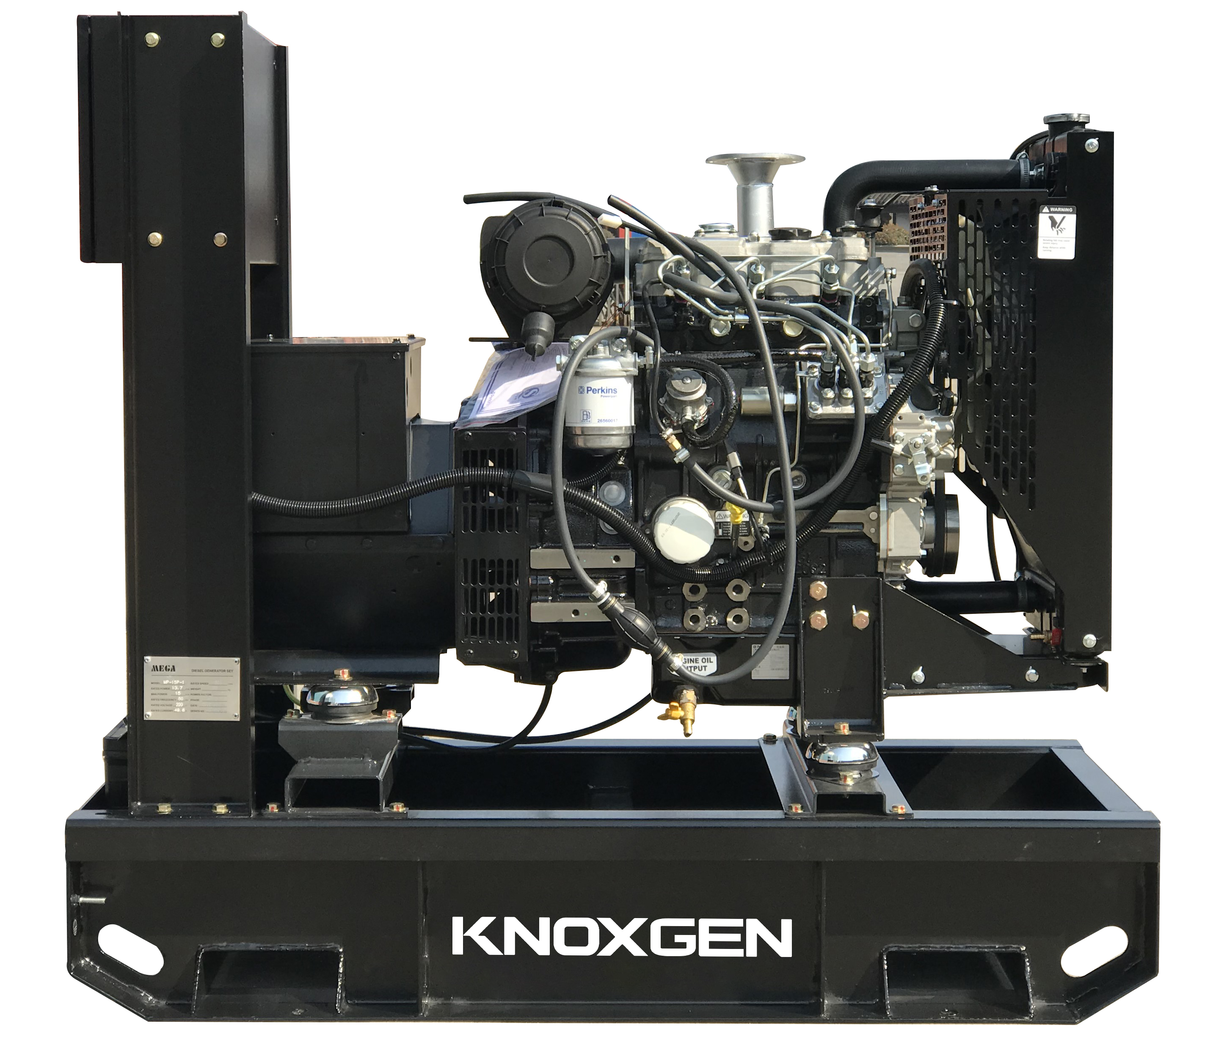
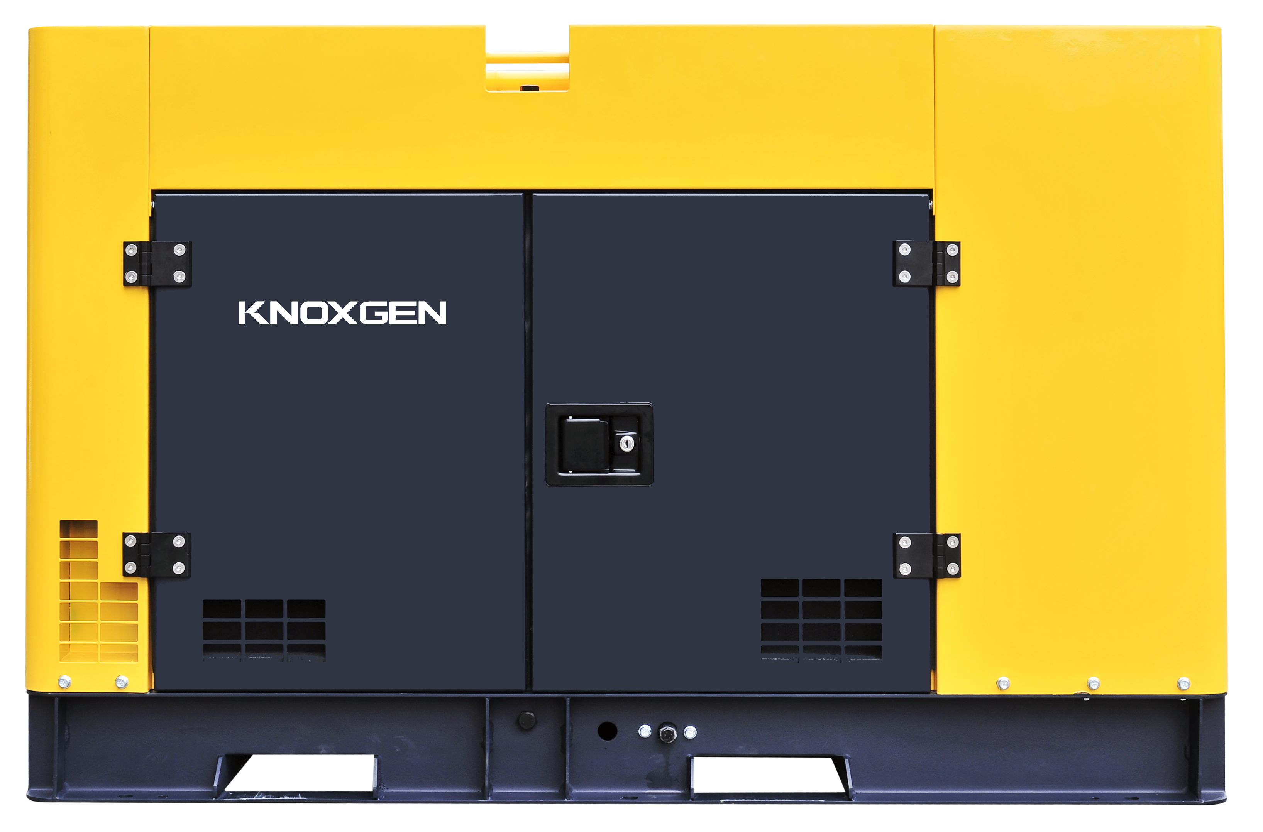
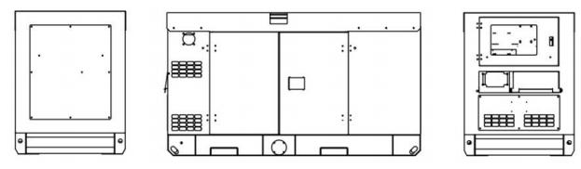
www.knoxgen.com
KDE28SS3-6
Diesel Generator Set
Powered by
General Features
• KNOXGEN Power provides one-source responsibility for the
generating system and accessories.
• The generator set and its components are prototype-tested,
factory-built, and production-tested.
• The generator set complies with ISO 8528-5, Class G3
requirements for transient performance.
• The generator set accepts rated load in one step.
• The 50Hz generator set engine is certified by the Environmental
Protection Agency (EU or MEP) to conform to EU2、EU3
nonroad emissions regulations.(≤560KW)
• A one-year limited warranty covers all systems and components.
Two-, five-, and ten-year extended warranties are also available.
PHOTO FOR REFERENCE ONLY
Technical Data
Output Frequency | 60 Hz
Rated Speed | 1800RPM
Prime Power | 25.0KVA/20.0KW
Standby Power | 27.5KVA/22.0KW
Rated Voltage | 220/380V
Dimension and Weight
Genset Type |  | Soundproof
Length(L) (mm) |  | 1840
Width(W) (mm) |  | 805
Height(H) (mm) |  | 1050
Gross Weight (kg) |  | 690
Specifications may change without prior notice 1/5

Slide 2
www.knoxgen.com
KDE28SS3-6
Diesel Generator Set
Powered by
Engine Specifications
Engine Brand Engine Model Cylinder No.& Configuration Working Mode Bore x Stroke Displacement Compression Ratio Rated Power Rated Speed Lubrication System Lube Oil Lube Oil Capacity Battery Capacity Fuel Type Fuel Consumption 25% load Fuel Consumption 50% load Fuel Consumption 75% load Fuel Consumption 100% load | KNOXGEN KD490D 4 cylinder Diesel L type Naturally Aspirated 90x100mm 2.54L 18 25kW 1800 Splash Lubrication Conforms above CD class or SAE10W-30, 15W-40 8L 6-QW-45(380)*1 Diesel:0#(Summer),-10#(Winter),-35#(Cold) 2.47L/H 3.69L/H 4.89L/H 6.35L/H
Specifications may change without prior notice 2/5

Slide 3
www.knoxgen.com
KDE28SS3-6
Diesel Generator Set
Powered by
Alternator Specification
Class H insulation
IP23 Protection
Automatic Voltage Regulator (AVR)
Optional for small gensets
Single bearing alternator
Class F or class B temperature rise (optional)
Digital Voltage Regulator (optional)
Double bearing (optional)
Anti-Condensation Heater (optional)
IP41 Protection (optional)
Electrical system
Maintenance-free and anti-explosion battery
Standard breaker
ABB breaker (optional)
ATS (optional)
Battery charger (optional)
GMS monitoring (optional)
Packing
Engine manual
Alternator manual
Gensets operation and maintenance manual
Tool kit
Baseframe
Forklift pockets
Pulling slots
Earth wire protection
Built-in anti vibration mountings
Fuel outlet value
Standard fuel tank
Enlarged fuel tank (optional)
Separated fuel tank (optional)
Canopy
Weatherproof & sound-attenated canopy
Sound-absorbing material
Lifting lug
Emergency stop button
Inside silencer
Specifications may change without prior notice 3/5

Slide 4
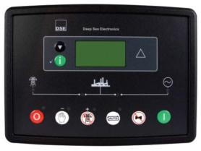
www.knoxgen.com
KDE28SS3-6
Diesel Generator Set
Powered by
Control System
Key Features
• Using microprocessor as a core, graphics LCD with big screenand backlight, key touch for operation
• Have a RS485 port, can be used for communicate to PC
• All parameters can be set from the front panel, or be set by PC used SG72
• Security password-protected programming levels
• All parameters use digital modulation, with higher reliability an stability
• Built-in speed/frequency detecting units can accurately judge
the states such as crank success and over speed
• Power supply range is wide, accommodating to different starting battery voltage environment
• Built-in watch dog can never be dead halt, ensuring smooth program execution
• Modular configuration design, inserted type connection terminals, flush type installation, compact structure, easy installation
Protection
• High engine temperature
• Low oil pressure
• Over speed
• Under speed
• Loss of speed signal
• Generator over frequency
• Generator under frequency
• Generator over voltage
• Generator under voltage
• Generator over current
• Fail to start
• Auxiliary inputs
Precision measure and display of controller
• Mains voltage • Mains frequency • Mains current • Generator voltage • Generator current • Generator frequency • Generator active power (kW) • Generator inactive power (kW) • Generator apparent power (kVA) | • Generator power factor • Generator starts count • Generator hour count • Cumulate electric energy (kWh) • Generator temperature • Generator pressure • Generator fuel level • Start battery voltage
Specifications may change without prior notice 4/5

Slide 5
www.knoxgen.com
KDE28SS3-6
Diesel Generator Set
Powered by
Optional
Engine | Fuel System | Control System
lWater Jacket Preheater | l Daily Fuel Tank | l Auto Remote Control Panel
lWater Separator | l External Fuel Tank | l AMF Function Control Panel
lOil Pump | l Auto Fuel Filling System | l Auto Paralleling Control Panel
lOil Preheater | l Fuel Level Sensor | l Auto Transfer Switch (ATS)
lBattery Charger |  | l ABB breaker
Alternator | Enclosure | Available Voltages
lAnti Condensation Heater | l RainproofType | l 440/254V
lPermanent Magnet Generator | l Soundproof Rental Type | l 415/240V
lWinding Temp Sensor | l Mobile Type | l 380/220V
Reference Standards
Generator Set:ISO9001, CE ，BS5000, ISO 8528, ISO 3046, IEC 60034, NEMA MG-1.22.
Engine:ISO 3046, BS 5514, DIN 6271
Alternator: BS EN 60034, IEC34, BS5000, NEMA MG1-32, VDE 0530, CSA C22.2-100, AS1359
Warranty
KNOXGEN Power provides a full line of brand new and high quality products. Each and every unit is strictly factory tested.
Warranty is according to our standard conditions: A. 15 months, counted on the day KNOXGEN sold to the first buyer; B. One year after installation; C. 1000 running hours (accumulated); subject to the earlier one.
Service and spare parts are available from KNOXGEN Power or distributors in your location.
Specifications may change without prior notice 5/5

